Slide 1
T
TRISHNA 3D
From floor plan
to walkable home.
Turn a drawing into a space people can explore.
A browser-based 3D reconstruction studio
PDF or image in. Interactive multi-storey model out.
DevDay Exchange Community Hackathon · Kochi · 2026
Notes:
Open with the user journey: a person can read a floor plan but cannot easily feel the spaces. Trishna 3D turns that drawing into a model people can inspect and walk through.
Source: README.md; src/components/BuildingViewer3D.tsx

Slide 2
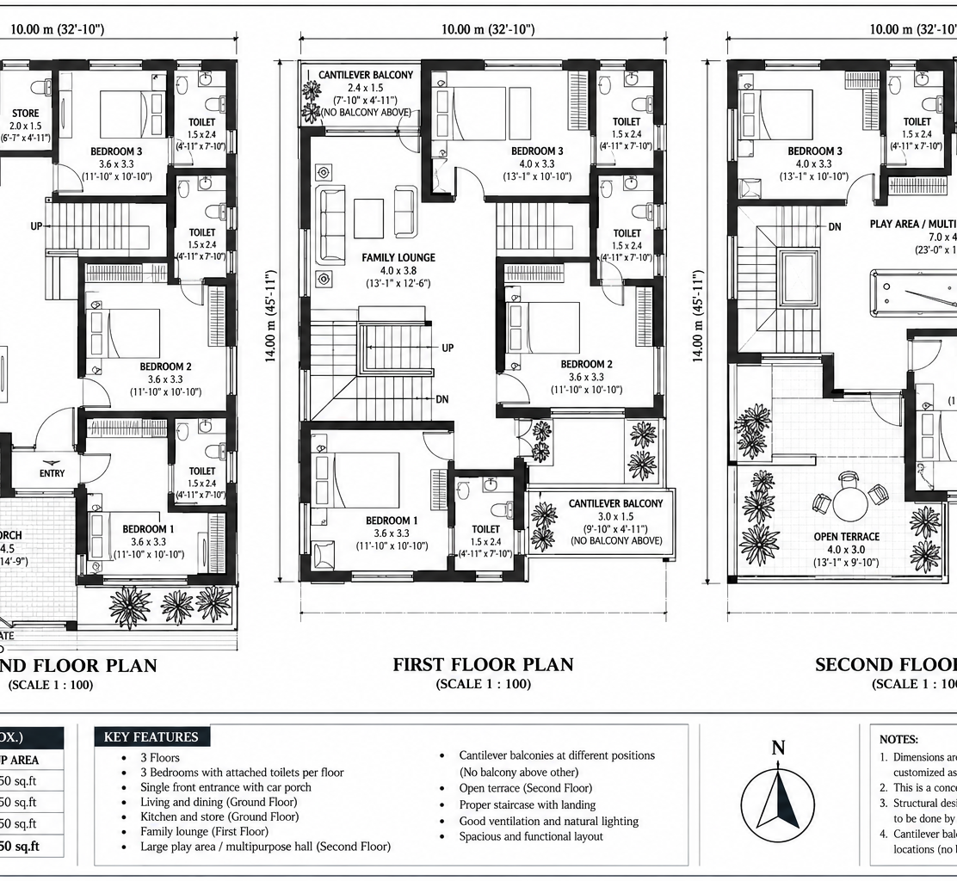
THE GAP
A plan shows rooms.
It hides the feeling of space.
Flat drawings leave people to imagine depth, movement and how floors connect.
DEPTH
How tall are the walls?
FLOW
Can I move between floors?
SCALE
How will it feel to live here?
A three-level home plan · 10 m × 14 m footprint
02
Notes:
The sample drawing contains three floors and a 10 by 14 metre footprint. A static view captures layout, but not the experience of moving through the home.
Source: public/extracted.png; public/three-floor-residence-drawing.pdf; README.md

Slide 3
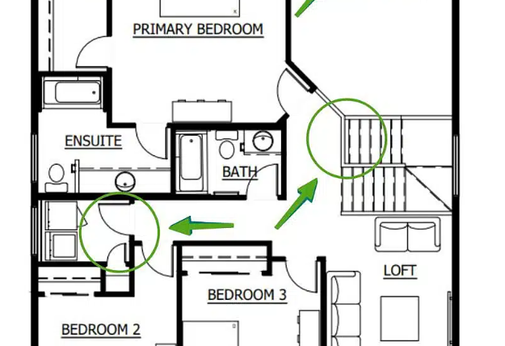
THE TRANSFORMATION
Make the plan something
people can step into.
One flow, from architectural drawing to interactive 3D.
01
READ
Upload a plan
PDF, PNG or JPG
02
EXPLORE
Move through it
Orbit or walk between floors
From a drawing to a place to understand.
03
Notes:
Explain the experience as three actions: upload, generate a spatial model, then explore it in orbit or first-person modes. Live Vision parsing can use Gemini; built-in sample models work without an API key.
Source: README.md; src/utils/parseFloorPlanPdf.ts; src/utils/geminiPlanAnalyzer.ts; src/components/BuildingViewer3D.tsx

Slide 4
HOW IT WORKS
From pixels to a navigable model.
Four focused steps keep the journey understandable.
01
02
03
04
Read
Interpret
Build
Explore
PDF.js reads vector and raster plan files in the browser.
Room labels, dimensions and openings become structured plan data.
Three.js assembles walls, slabs, doors and connected levels.
Orbit the model or walk through the rooms and stairs.
PDF.js · browser parsing
Gemini Vision · optional
TypeScript · Three.js
Orbit · first-person
The sample home runs locally; live analysis of new uploads needs a Gemini API key.
04
Notes:
Walk through the browser pipeline. PDF.js handles document parsing. Gemini is an optional service for live vision analysis of custom uploads; built-in samples allow an offline walkthrough.
Source: README.md; src/utils/parseFloorPlanPdf.ts; src/utils/geminiPlanAnalyzer.ts; src/components/BuildingViewer3D.tsx

Slide 5
THE EXPERIENCE
Watch it rise. Then walk it.
The model is not a still render: it assembles level by level and stays interactive.
02 WALK
Follow the stairs
through all three levels.
First-person movement, orbit view and doors that open as you approach make the layout easier to read.
DEMO MODEL
01 BUILD
10 m × 14 m · 3 floors · 7-second build
Ground → first → second → terrace
05
Notes:
Use the live demo to show the progressive build, then switch to first-person and climb the connected stairs. The seven-second duration belongs to the bundled residence build animation.
Source: src/components/BuildingViewer3D.tsx; src/data/sampleResidencePlan.ts; SUBMISSION.md

Slide 6
BUILT FOR THE BROWSER
A lightweight studio,
with a real 3D engine.
INTERFACE
React 18 + TypeScript
Upload · inspect · control
No cloud render queue between the drawing and the walkthrough.
PLAN UNDERSTANDING
PDF.js + optional Gemini Vision
Read drawings · extract spatial cues
RENDER
SPATIAL MODEL
WebGL 2
TypeScript plan schema
Room boundaries · levels · openings
ASSEMBLE
REAL-TIME EXPERIENCE
Walls, floors, openings and stairs are generated from the plan structure.
Three.js + WebGL
Procedural geometry · navigation
06
Notes:
Show that the system is a web app: React and TypeScript coordinate the user experience, PDF.js parses documents, Gemini vision is optional, and Three.js renders the navigable model.
Source: README.md; package.json; src/utils/parseFloorPlanPdf.ts; src/utils/geminiPlanAnalyzer.ts; src/components/BuildingViewer3D.tsx

Slide 7
TRISHNA 3D
Let people experience
the space before it exists.
A 2D home plan becomes a multi-storey place to explore.
Open the live demo
github.com/Deonjohny/Trishna-3D
Prototype built at DevDay Exchange Community Hackathon · Kochi · 11 Oct 2026
Notes:
Close on what changes for the audience: people can understand the space before construction begins. Invite the judges to try the live local demo and climb between levels.
Source: README.md; SUBMISSION.md; src/components/BuildingViewer3D.tsx

